Slide 1

EMOTION ANALYSIS ON VACCINE RELATED TWEETS
Akash Bunde
Harsh Jain
Manika Kondaparthy
Laya Dudi

Slide 2
Background
With the rise of technological use in recent years, it has been easier for anyone to communicate their emotions and opinions regarding hot topics like COVID-19 on prominent social media sites like Twitter.

Slide 3
Objective
The two goals of this study were to identify and analyse significant themes and topics related to vaccination-related tweets made by individuals , as well as to analyze trends in the emotions of the tweets from various themes and topics on a weekly basis.
Time Period : April 25th – July 15th 2021
Data Source : Panacea Lab Data
https://github.com/thepanacealab/covid19_twitter

Slide 4
Research Model
Data retrieval from Panacea Lab
Data cleaning : Individual vs Organisation filtering, Vaccine related tweets filtering
Sentiment analysis using VADER and BERT
Used LDA and Anchored Corex to group tweets into topics

Slide 5
VOLUME OF DATA AT EVERY STEP
 | Number of tweets per day
INITIAL DATA | 52,82,992
TWEET_ID FILTERING | 45,242
IND_ORG FILTERING | 34,474
VACCINE FILTERING | 20,000

Slide 6
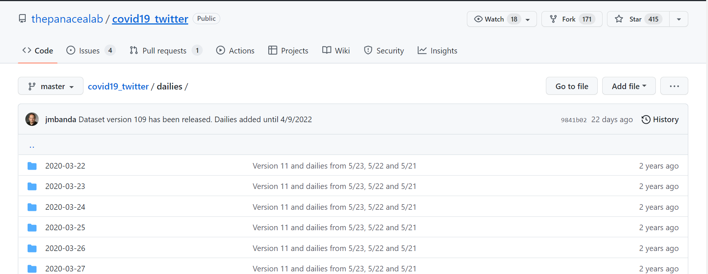
Data Collection from Panacea Lab

Slide 7
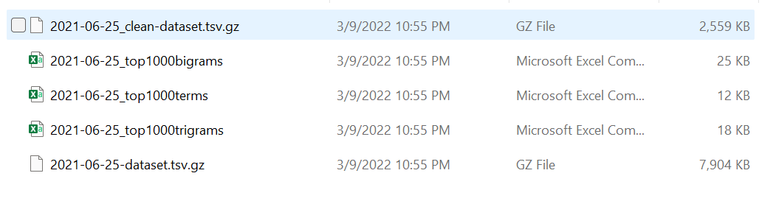
Components available inside one day’s data

Slide 8
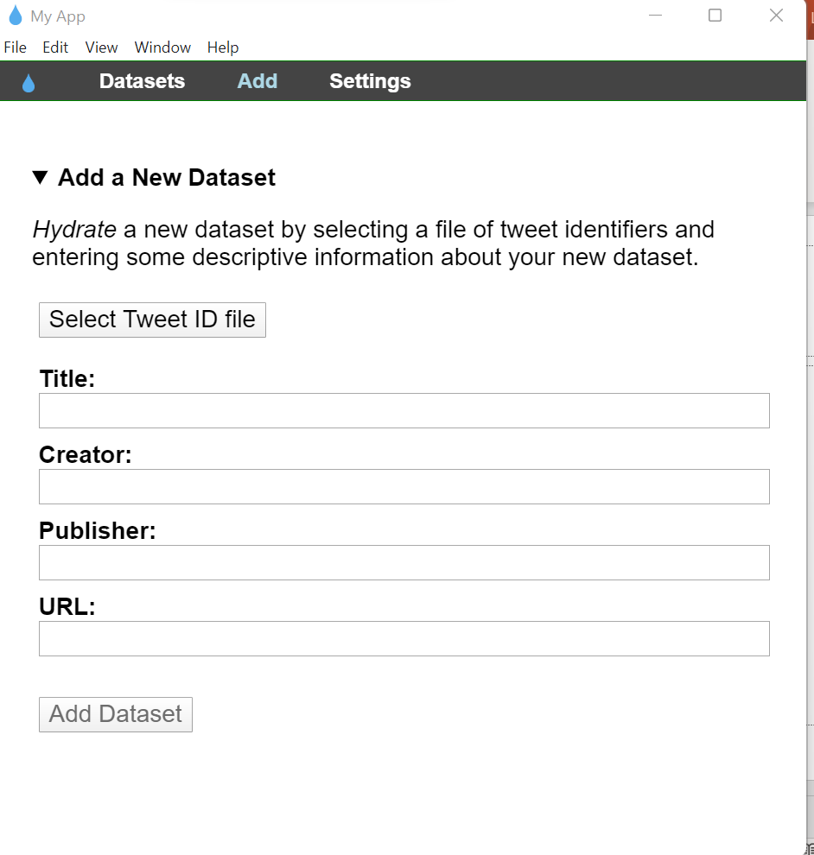
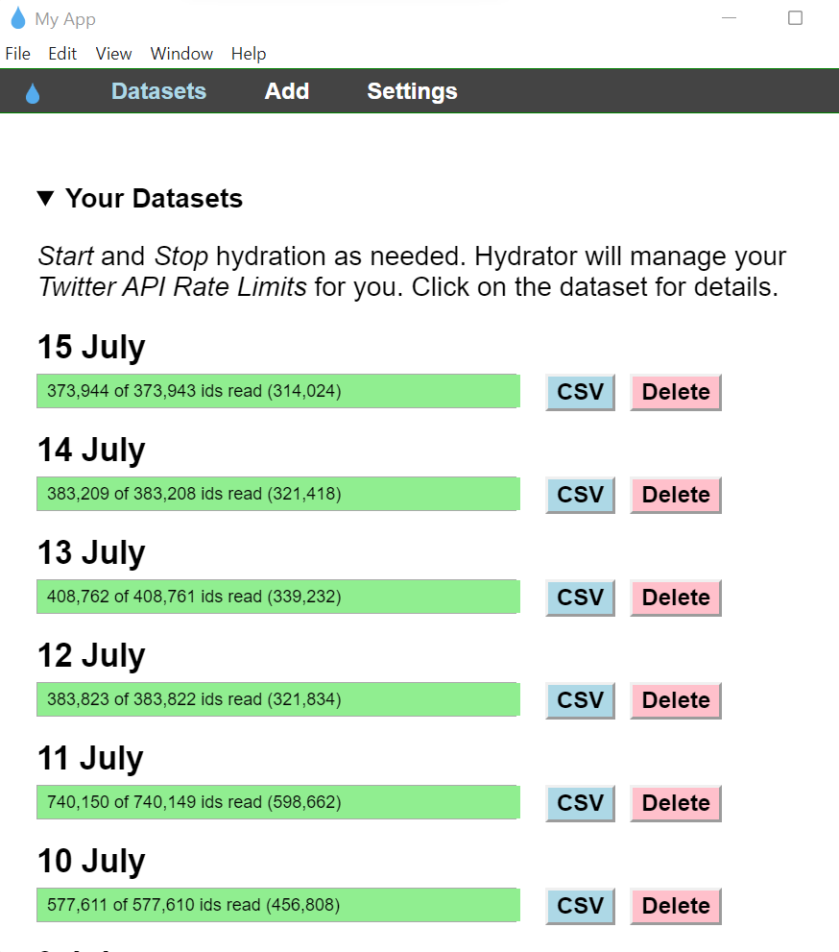
Hydrator : Retrieving twitter data using tweet ID

Slide 9
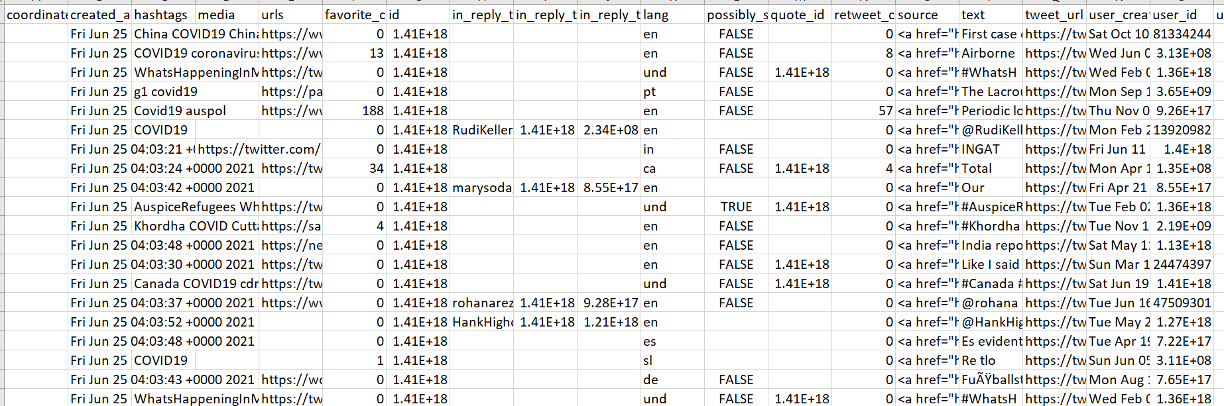
Snapshot of the data:

Slide 10
Data - Columns
coordinates
created_at
hashtags
media
urls
favorite_count
id
in_reply_to_screen_name
in_reply_to_status_id
in_reply_to_user_id
lang
possibly_sensitive
quote_id
retweet_count
source
text
tweet_url
user_created_at
user_id
user_default_profile_image
user_description
user_favourites_count
user_followers_count
user_friends_count
user_listed_count
user_location
user_name
user_screen_name
user_statuses_count
user_time_zone
user_urls
user_verified
Each day - Almost 2,20,000 tweets
Data for 12 weeks -
17,577,440 tweets

Slide 11
Categorising the source of a tweet : Was it made by an individual or an organisation?
We used Demographer to differentiate tweets made by individuals and organizations.
Demographer is a Python package that predicts demographic characteristics from information in a single tweet.
It's designed for Twitter, where it takes the user information and returns information about their likely demographics.
IndividualOrgDemographer : classifies users as individuals or organizations from username and profile features
NeuralOrganizationDemographer : classifies users as individuals or organizations with a neural model of username and profile features.

Slide 12
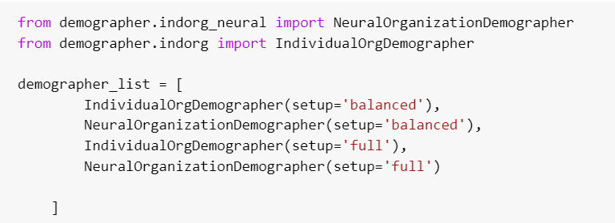
Categorisation : Individual vs Organisational

Slide 13
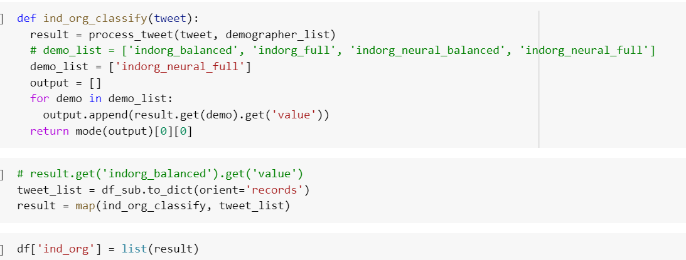
Categorisation : Individual vs Organisational

Slide 14
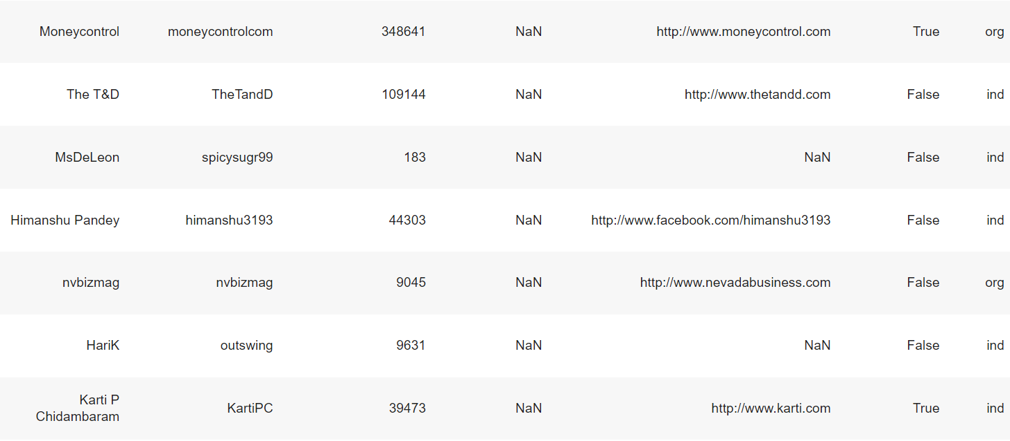
Output for Individual vs Organisation Classification

Slide 15
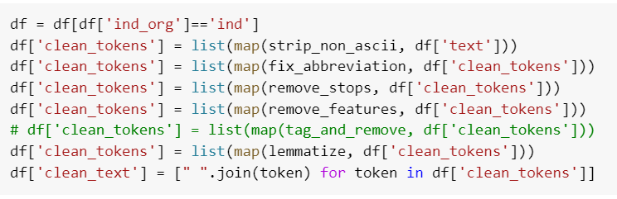
DATA CLEANING
We filtered the tweets made by individuals
Next, we cleaned all the tweets by removing the punctuations, links and stop words and lemmatized them.

Slide 16
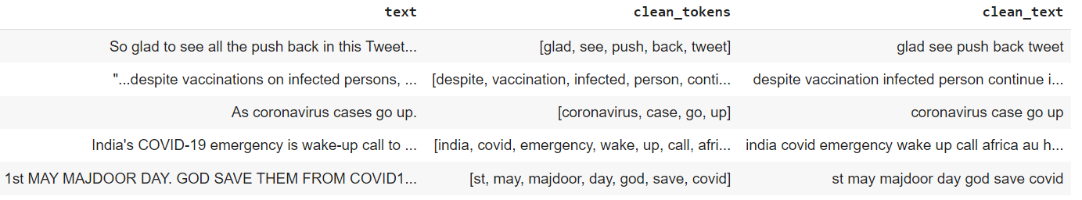
Output post data lemmatization and cleaning:

Slide 17
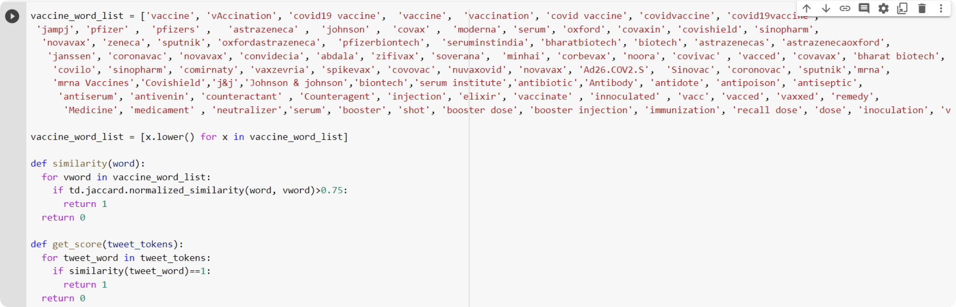
Filtering tweets based on their relevance to vaccination
We compared the words with the words in the tweets and based on the similarity score, filtered only the tweets related to vaccines.

Slide 18
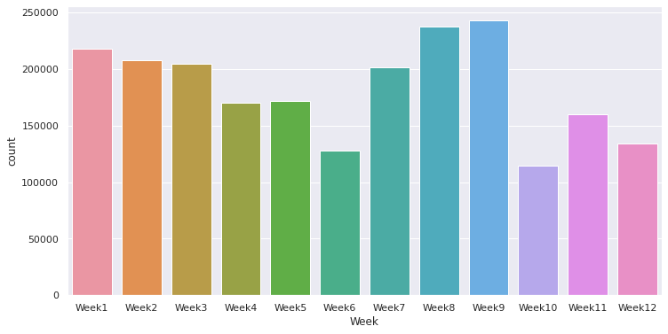
Volume of data per week (10L tweets in total)

Slide 19
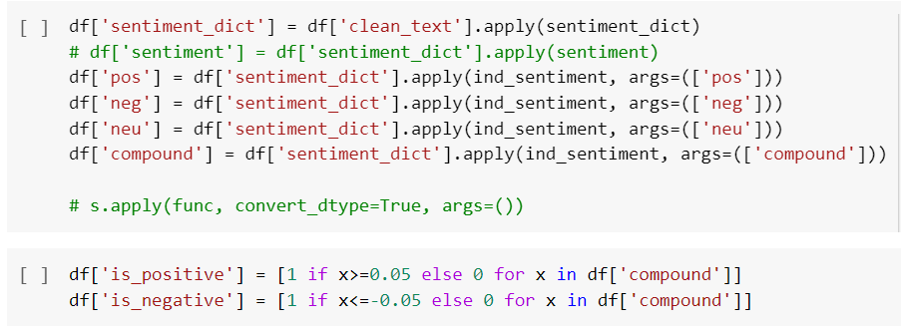
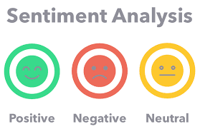
Vader Analysis
VADER Sentiment Analysis. VADER (Valence Aware Dictionary and sentiment Reasoner) is a lexicon and rule-based sentiment analysis tool that is specifically attuned to sentiments expressed in social media and works well on texts from other domains.
Best Thresholds for splitting Vader tweet sentiments: sentiment['compound'] < 0.05 => Negative.
sentiment['compound'] > 0.05 => Positive .

Slide 20
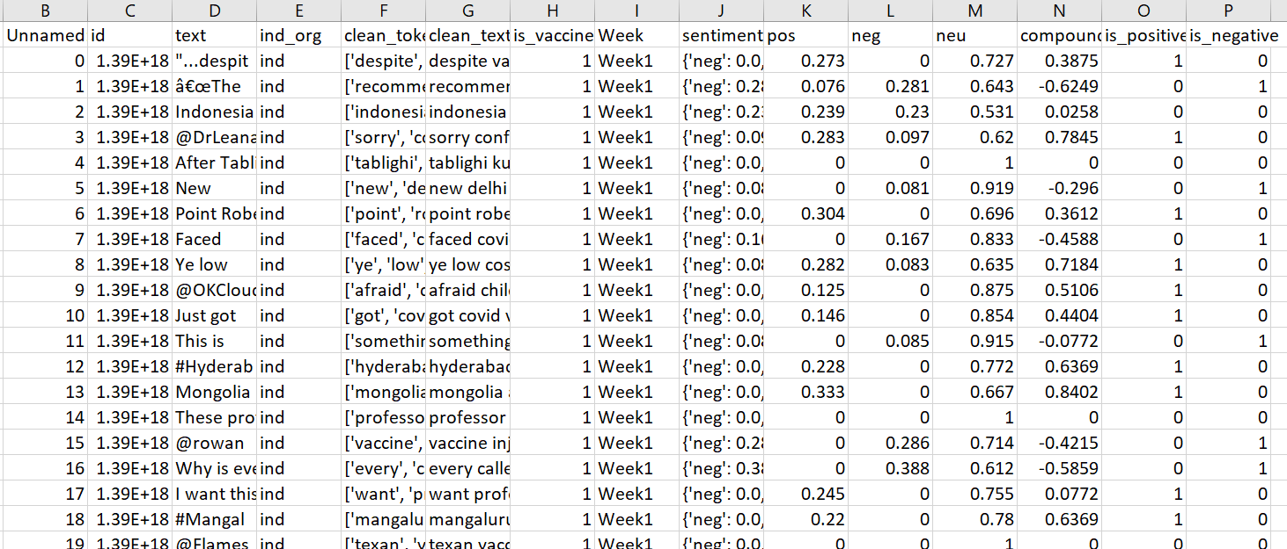
Vader Analysis - Output

Slide 21
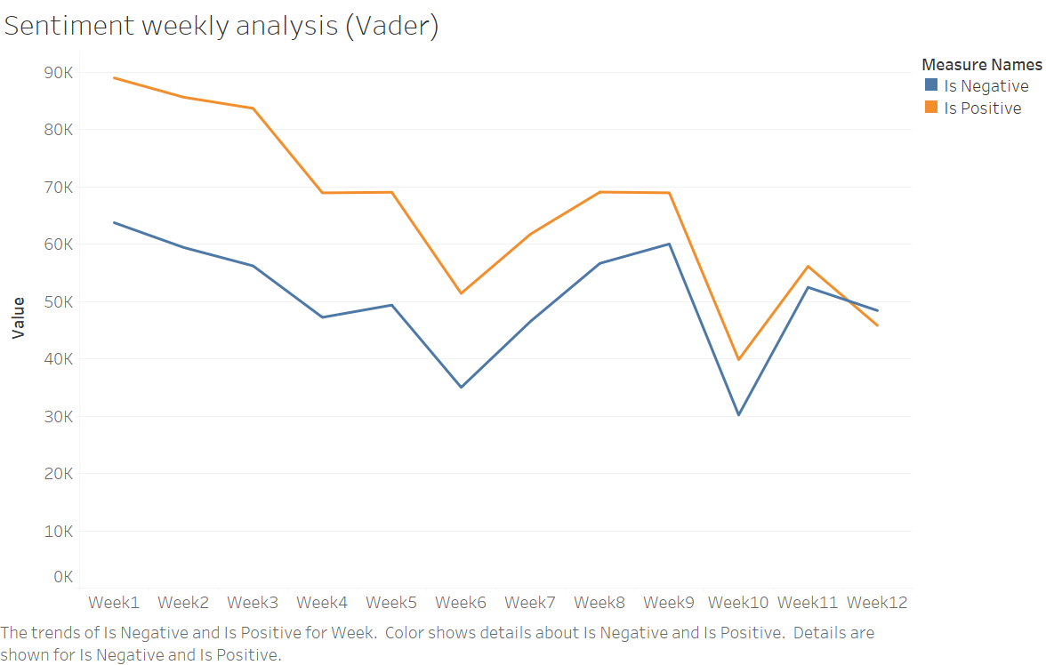
VADER - Weekly Analysis

Slide 22
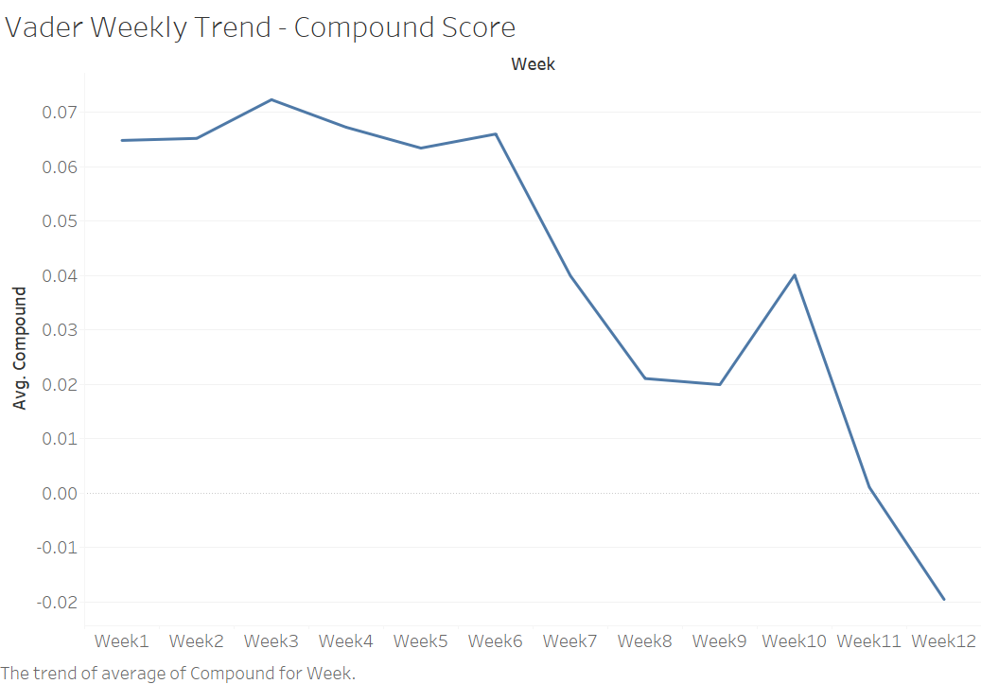
VADER - Weekly Analysis

Slide 23
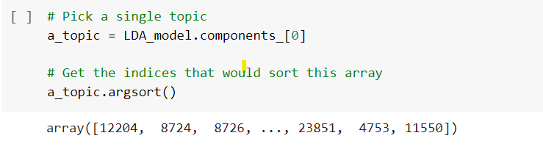
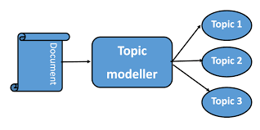
Latent Dirichlet Allocation (LDA)
LDA is a generative probabilistic model that assumes each topic is a mixture over an underlying set of words, and each document is a mixture of over a set of topic probabilities.

Slide 24
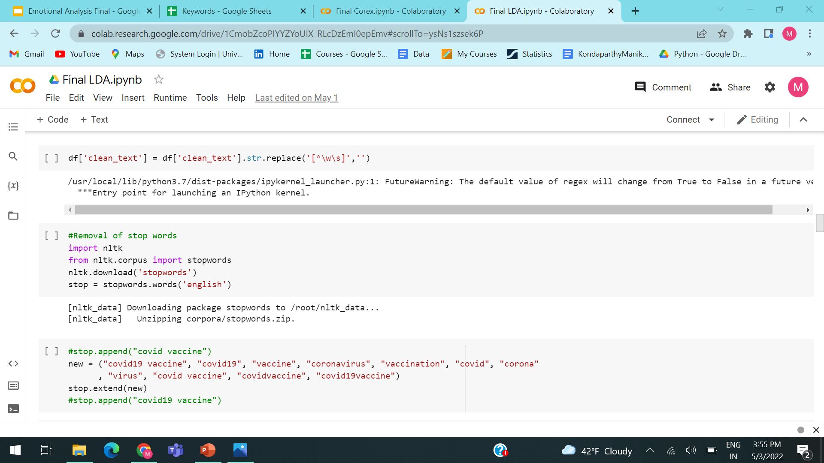
Adding additional stop words before running LDA

Slide 25
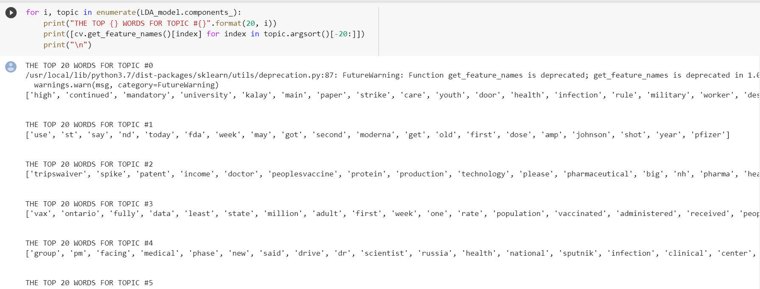
Top words retrieved from LDA

Slide 26
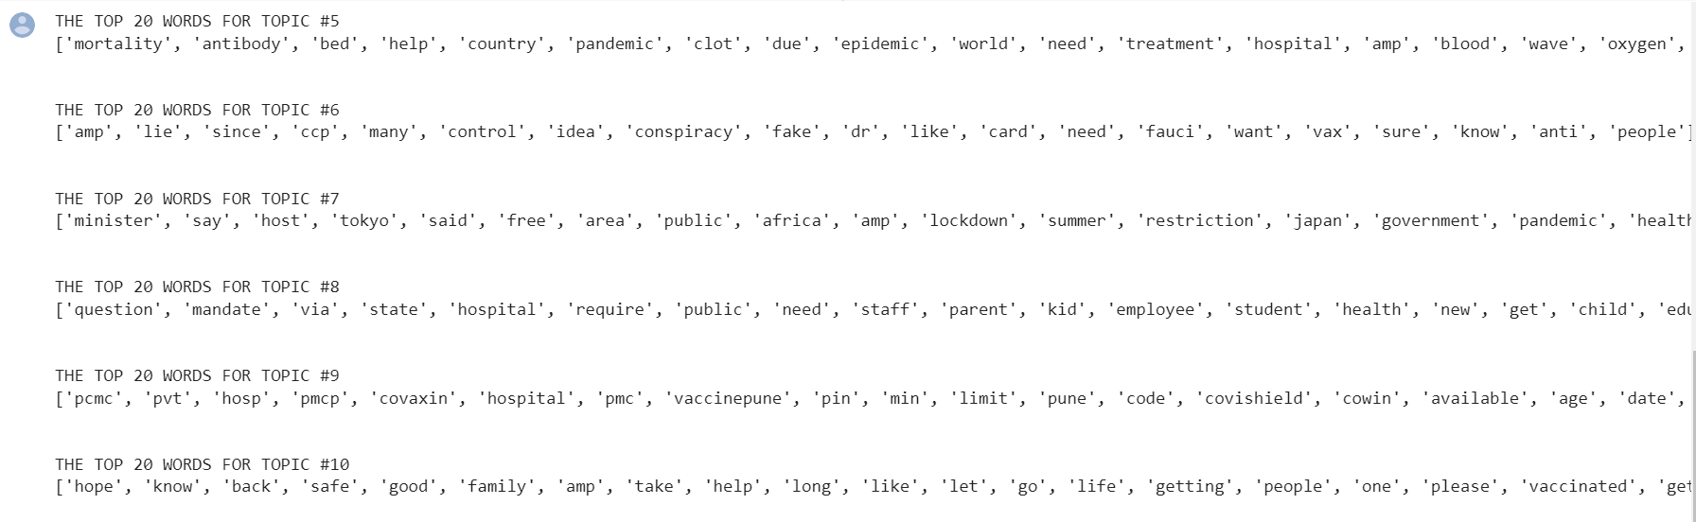
Top words retrieved from LDA

Slide 27
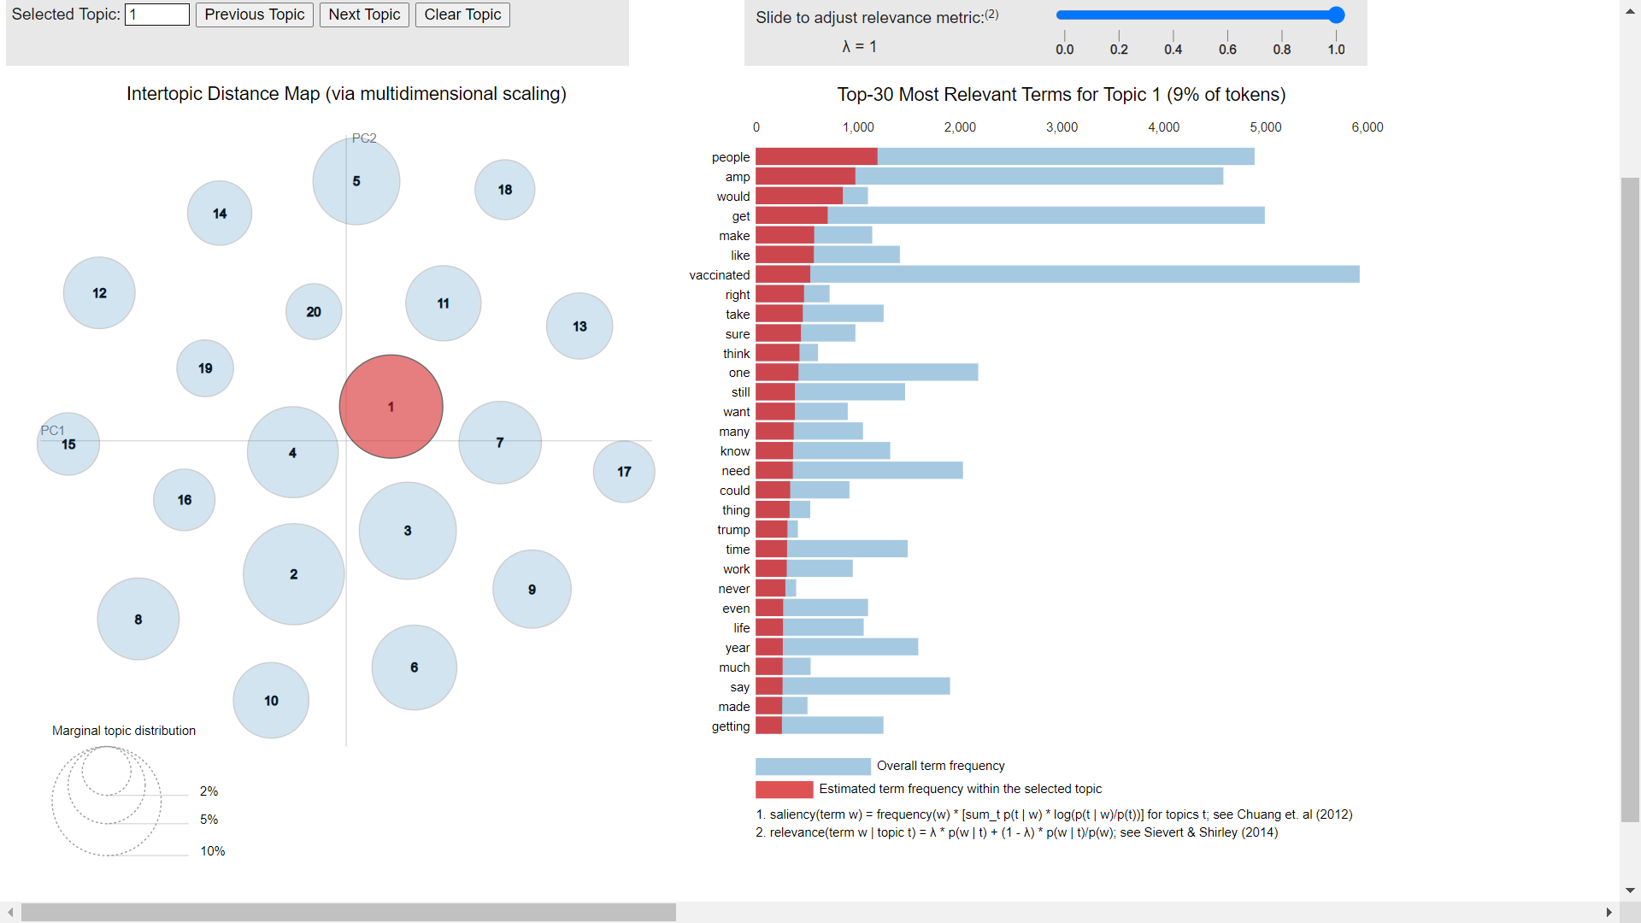
LDA Output

Slide 28
COREX
Correlation Explanation (CorEx) topic model makes few assumptions about the latent structure of the data, and flexibly incorporates domain knowledge through user-specified “anchor words.”
Through these anchor words, we can seed and guide the topic model towards topics of our main interest, which allows us to interact with and refine topics in a way that is not possible with traditional topic models.

Slide 29
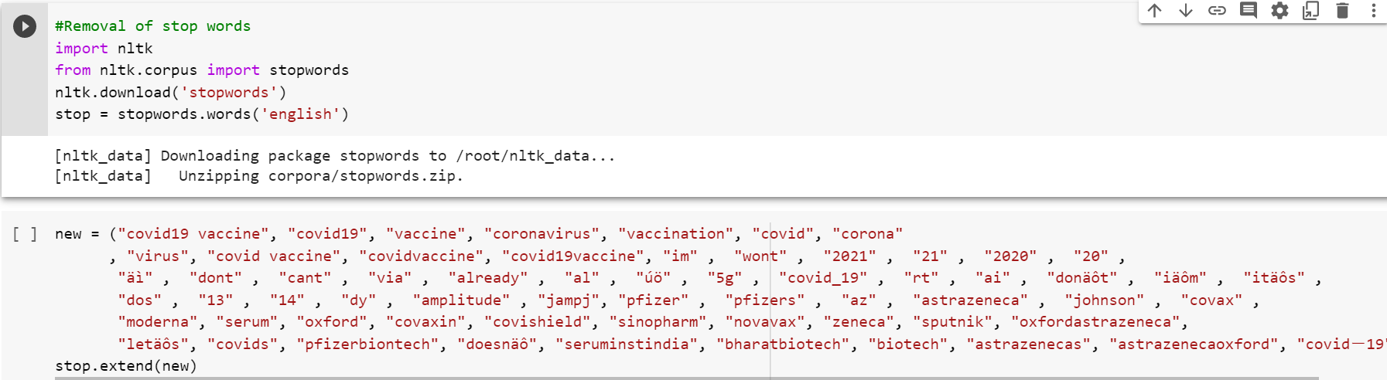
Removal of additional stop words

Slide 30
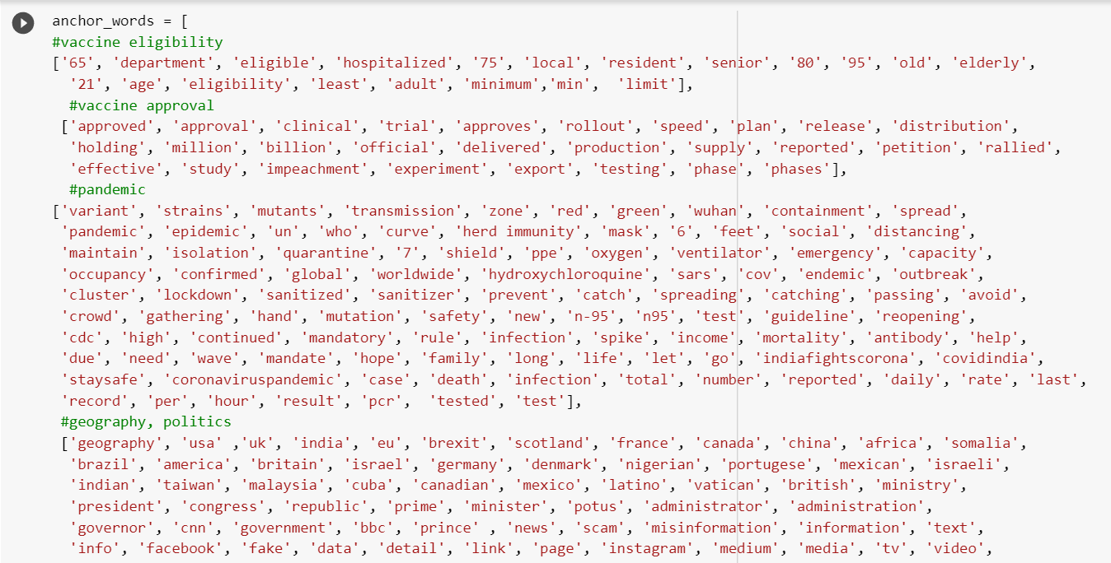
Anchor Words used in Corex

Slide 31
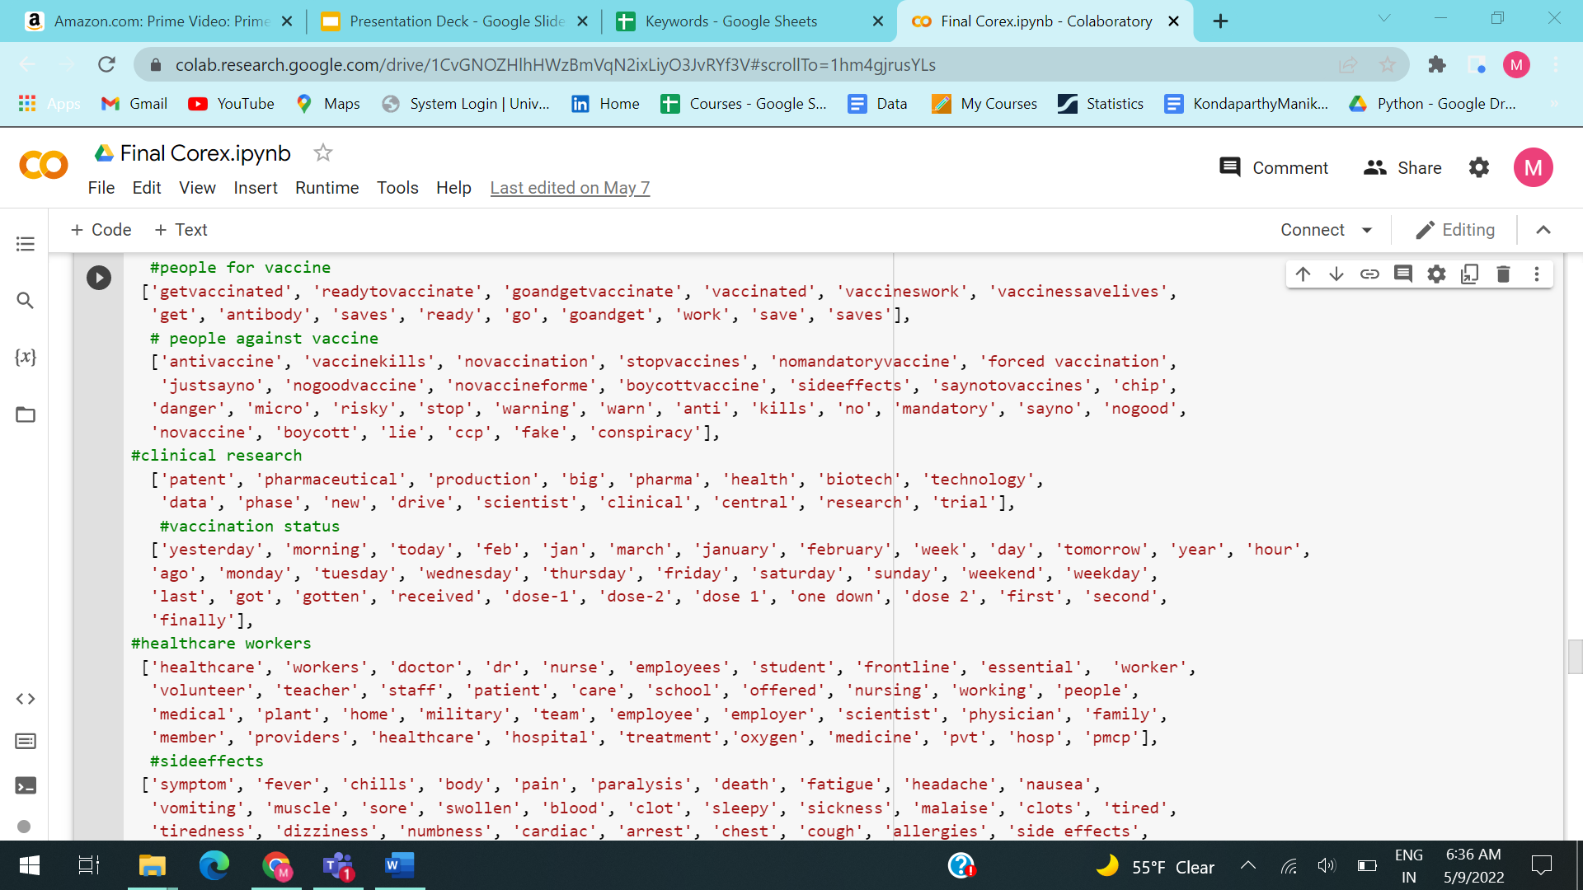
Anchor Words used in Corex

Slide 32
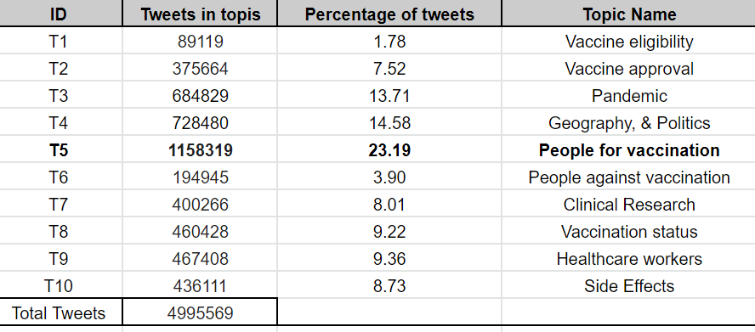
Labels.txt Output

Slide 33
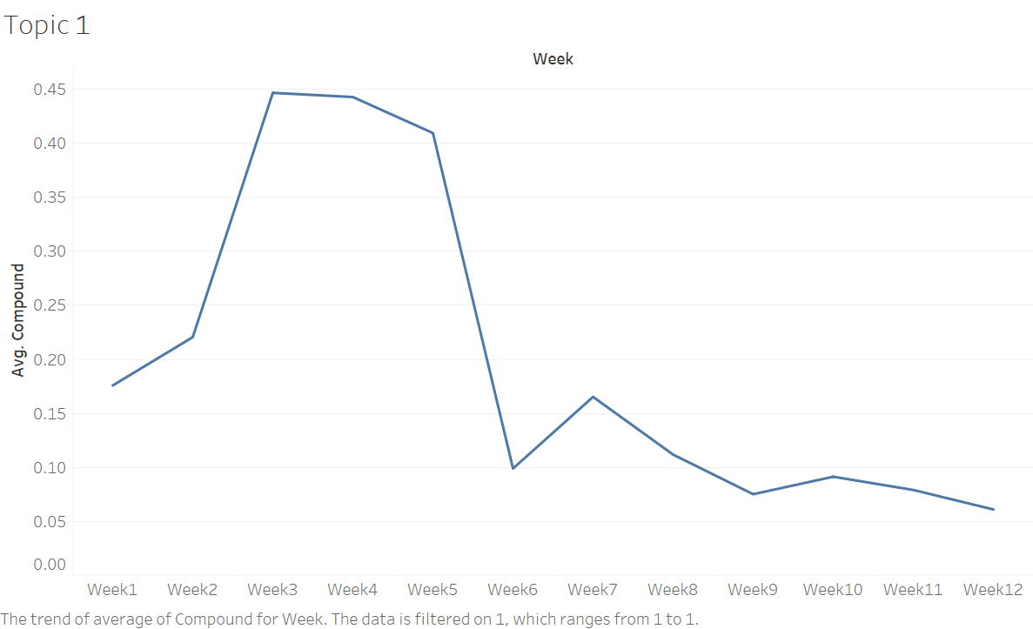
Weekly sentiment analysis for tweets related to vaccine eligibility
Notes:
metric that calculates the sum of all the lexicon ratings which have been normalized between -1(most extreme negative) and +1 (most extreme positive).

Slide 34
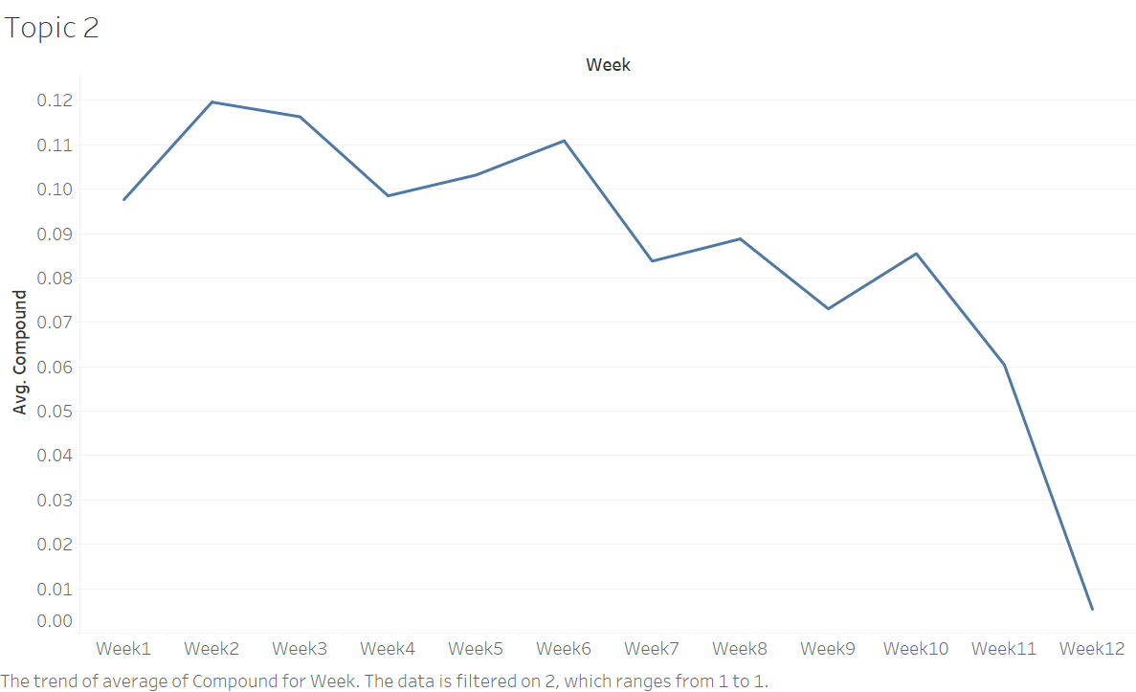
Weekly sentiment analysis for tweets related to vaccine approval

Slide 35
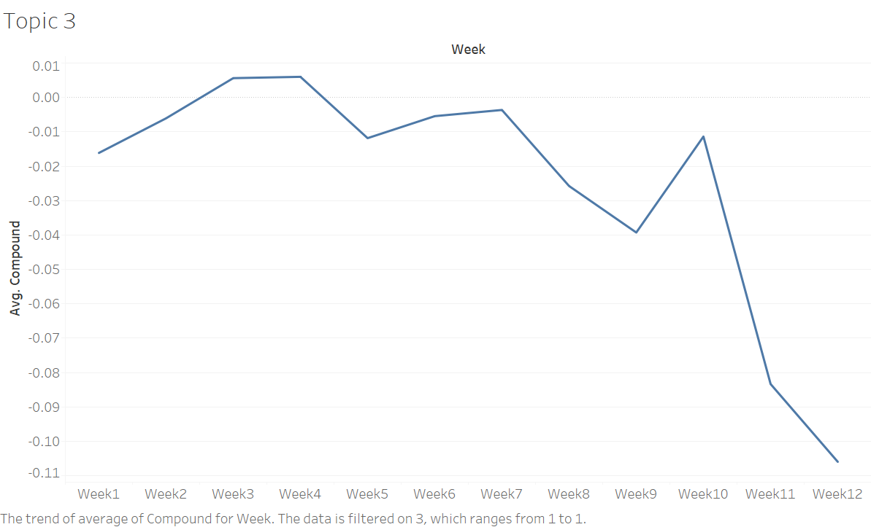
Weekly sentiment analysis for tweets related to the pandemic

Slide 36
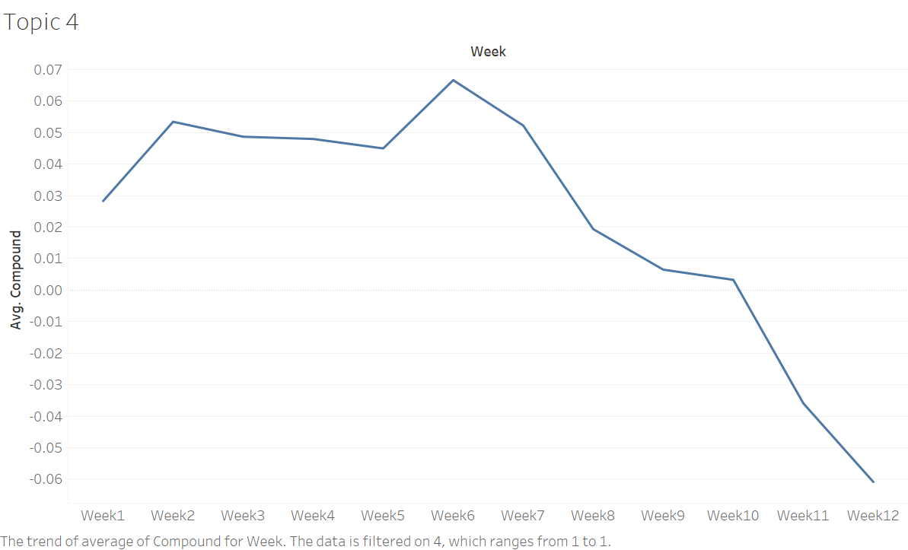
Weekly sentiment analysis for tweets related to the geography and politics

Slide 37
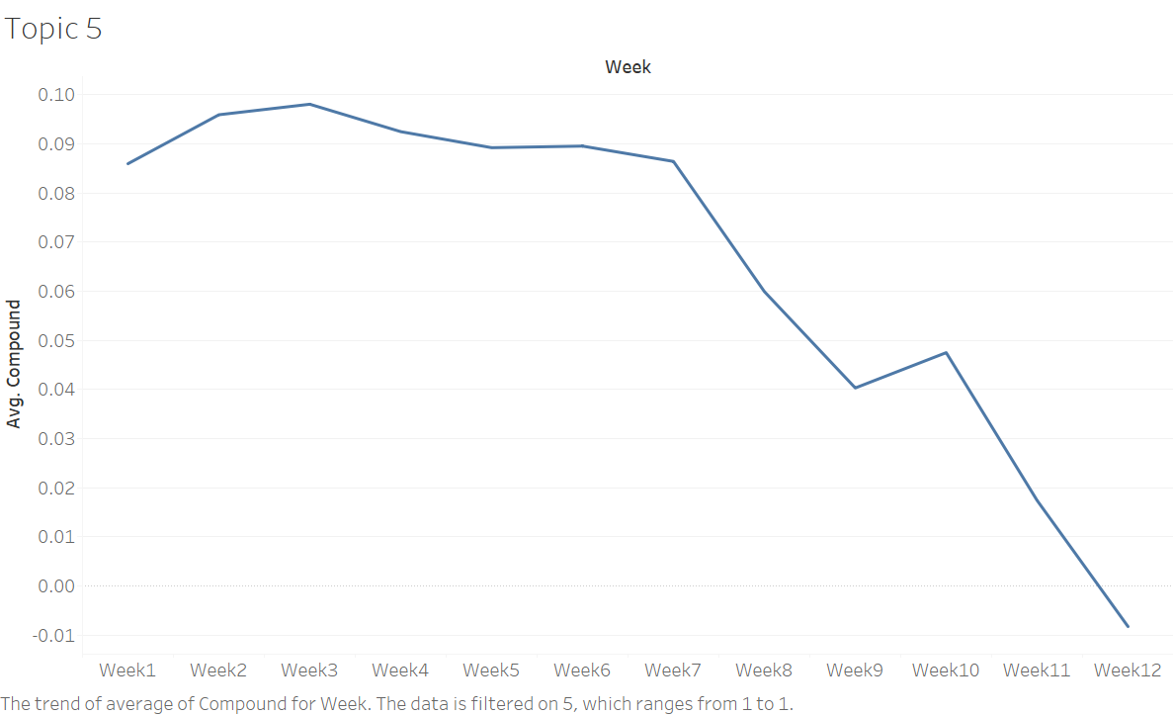
Weekly sentiment analysis for tweets related to tweets FOR vaccination

Slide 38
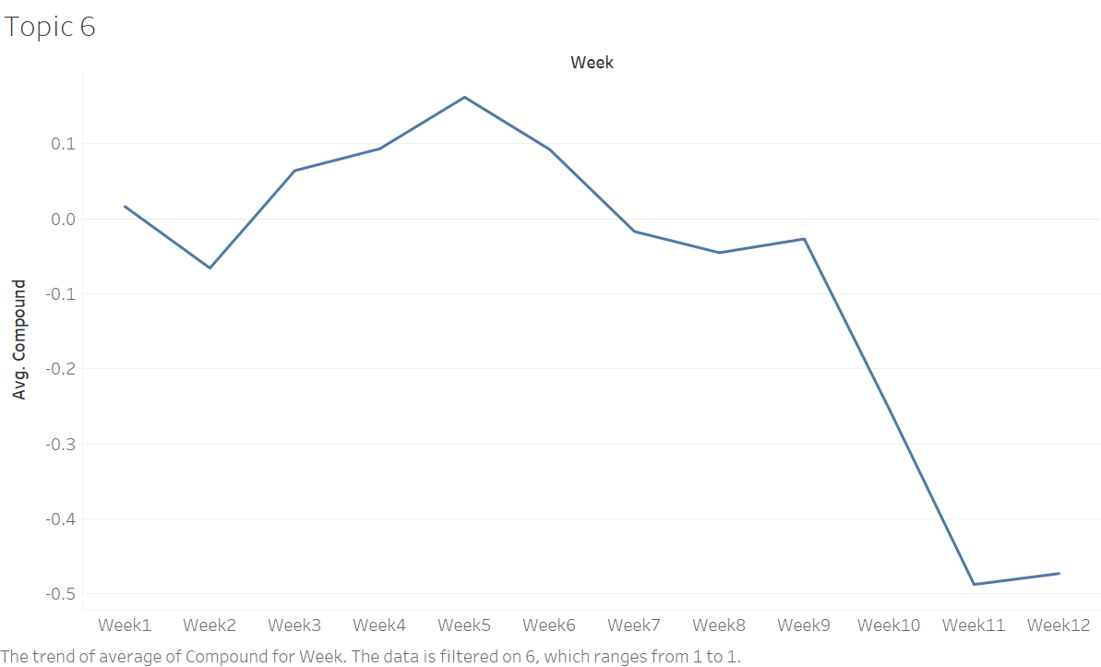
Weekly sentiment analysis for tweets related to tweets against vaccination

Slide 39
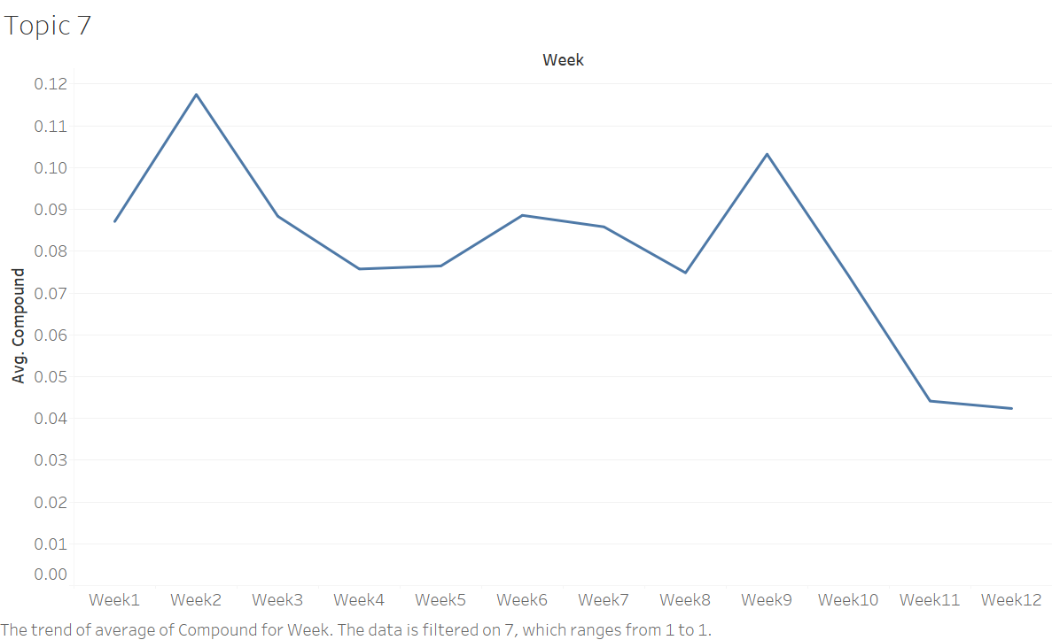
Weekly sentiment analysis for tweets related to R&D

Slide 40
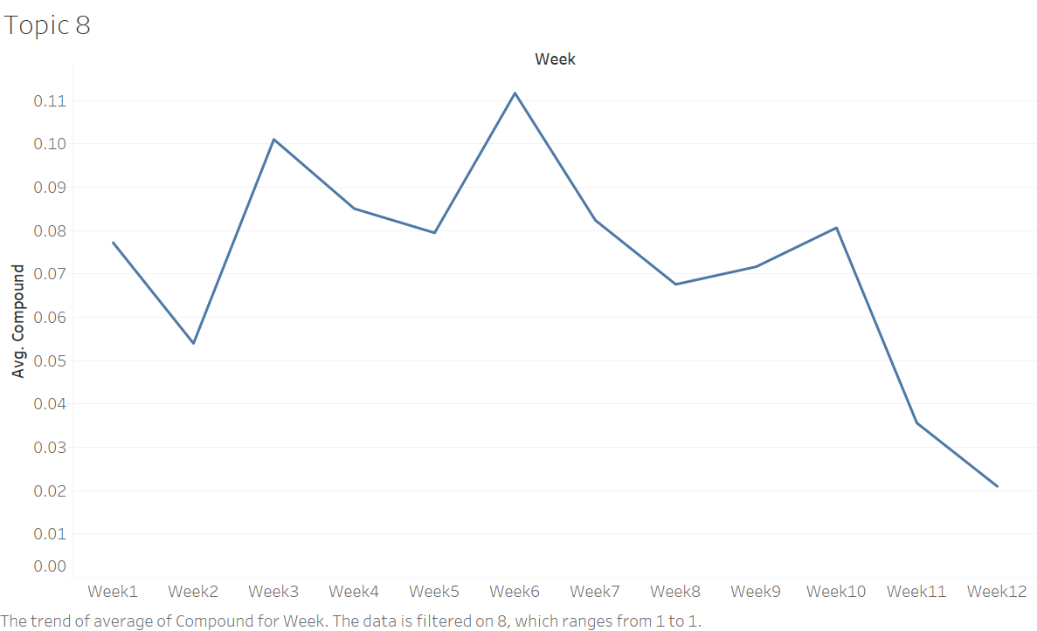
Weekly sentiment analysis for tweets related to vaccination status

Slide 41
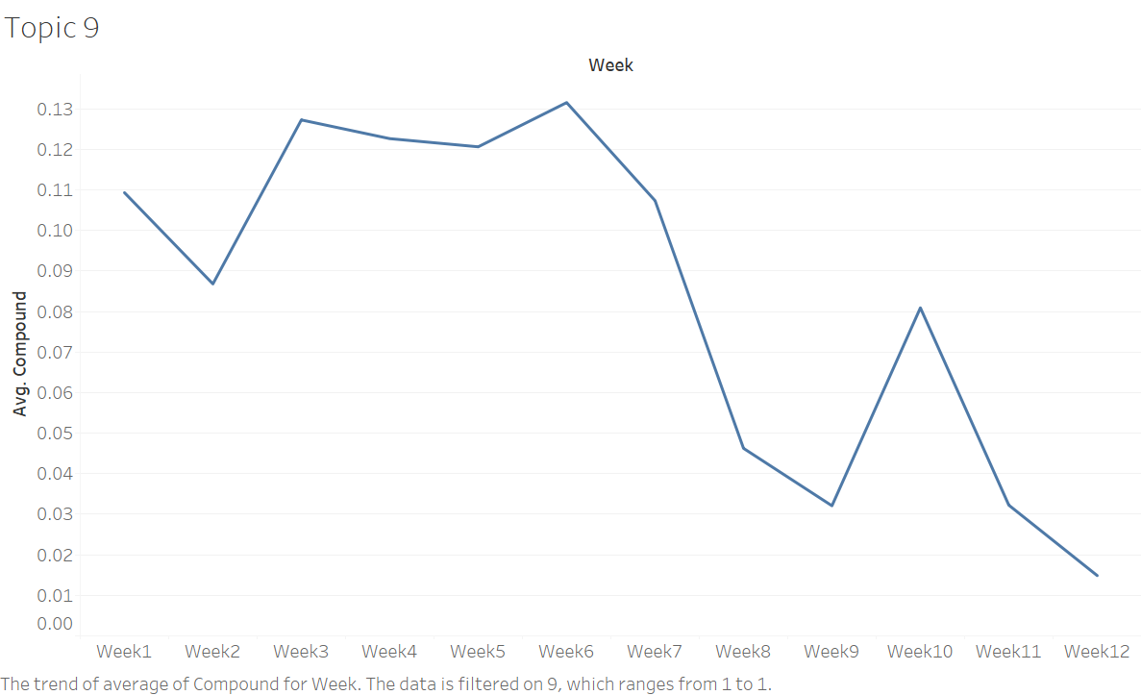
Weekly sentiment analysis for tweets related to healthcare workers

Slide 42
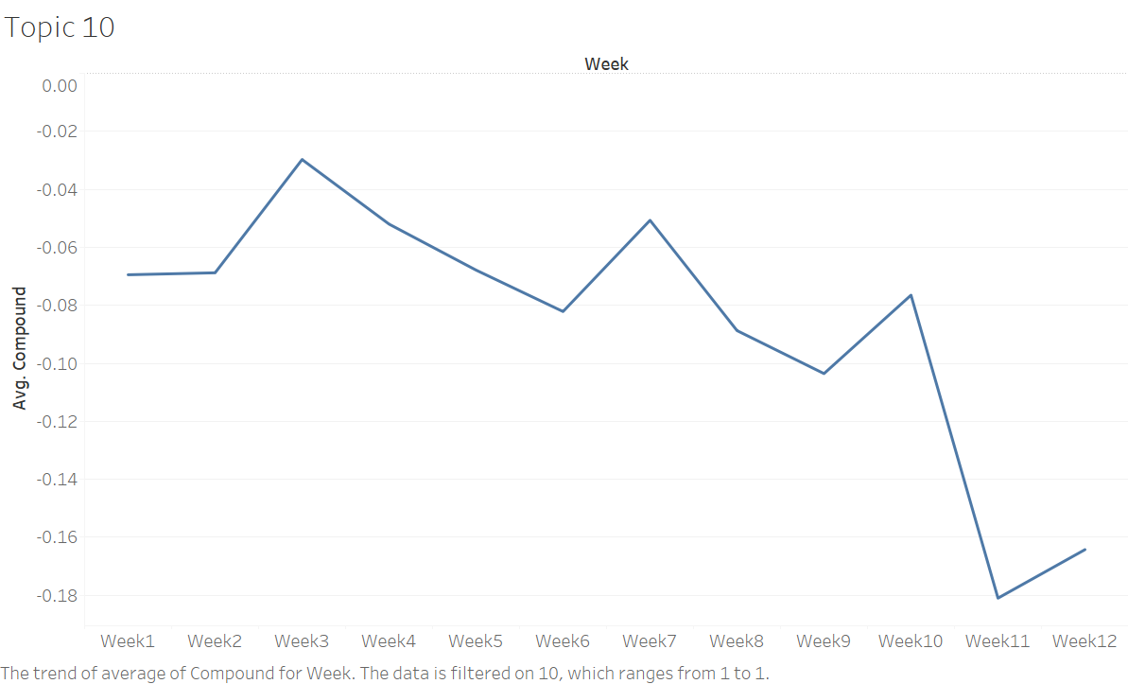
Weekly sentiment analysis for tweets related to side effects

Slide 43
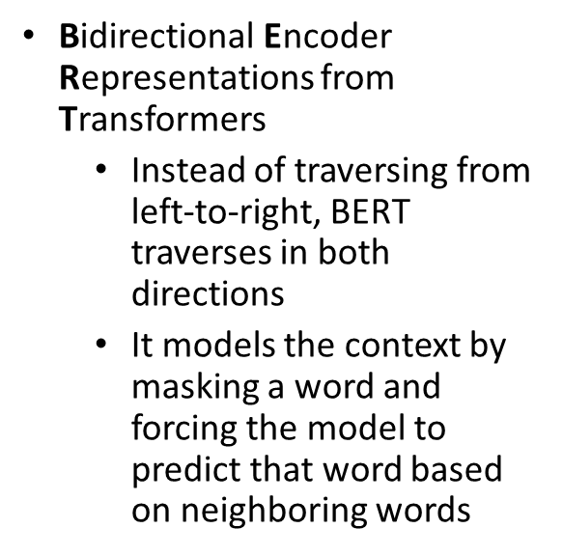
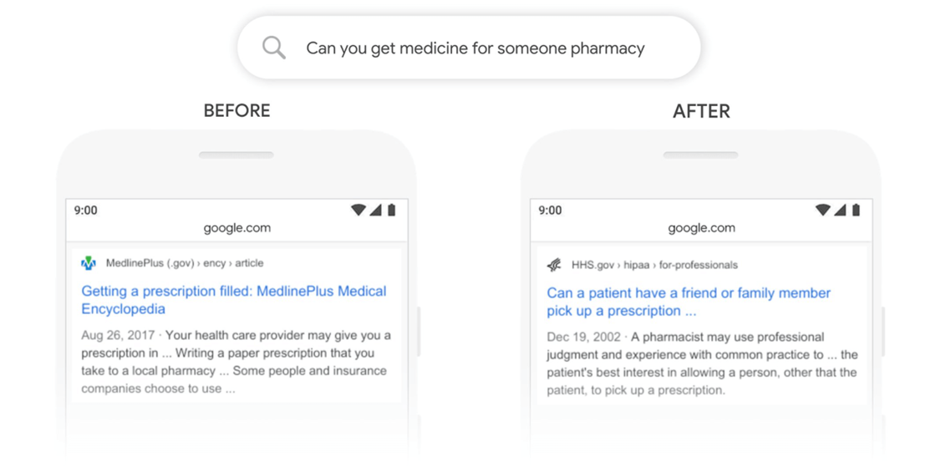
BERT (semi-supervised)

Slide 44
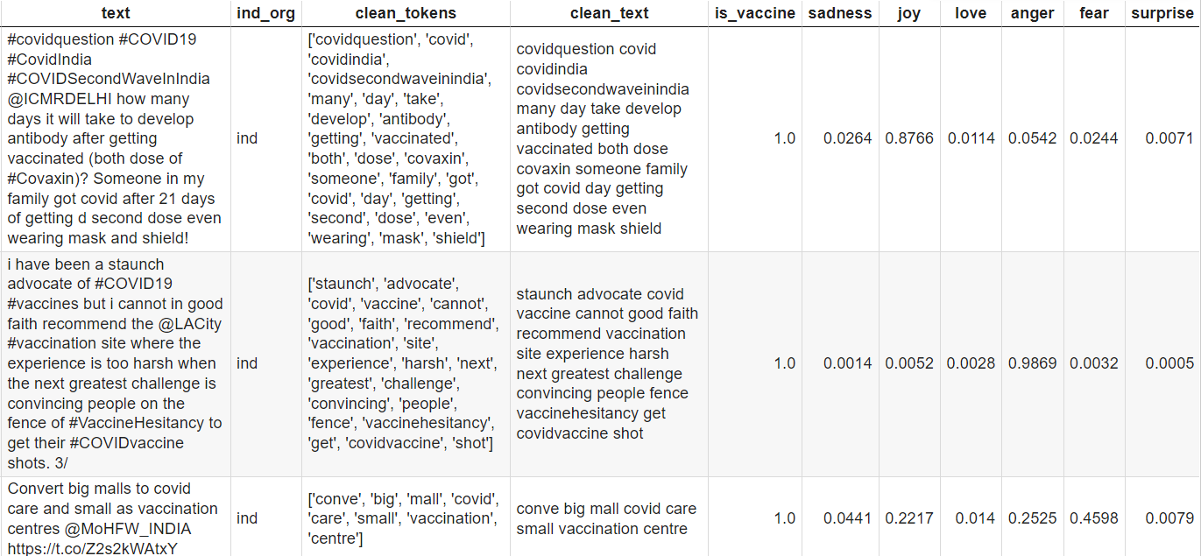
BERT (output)

Slide 45
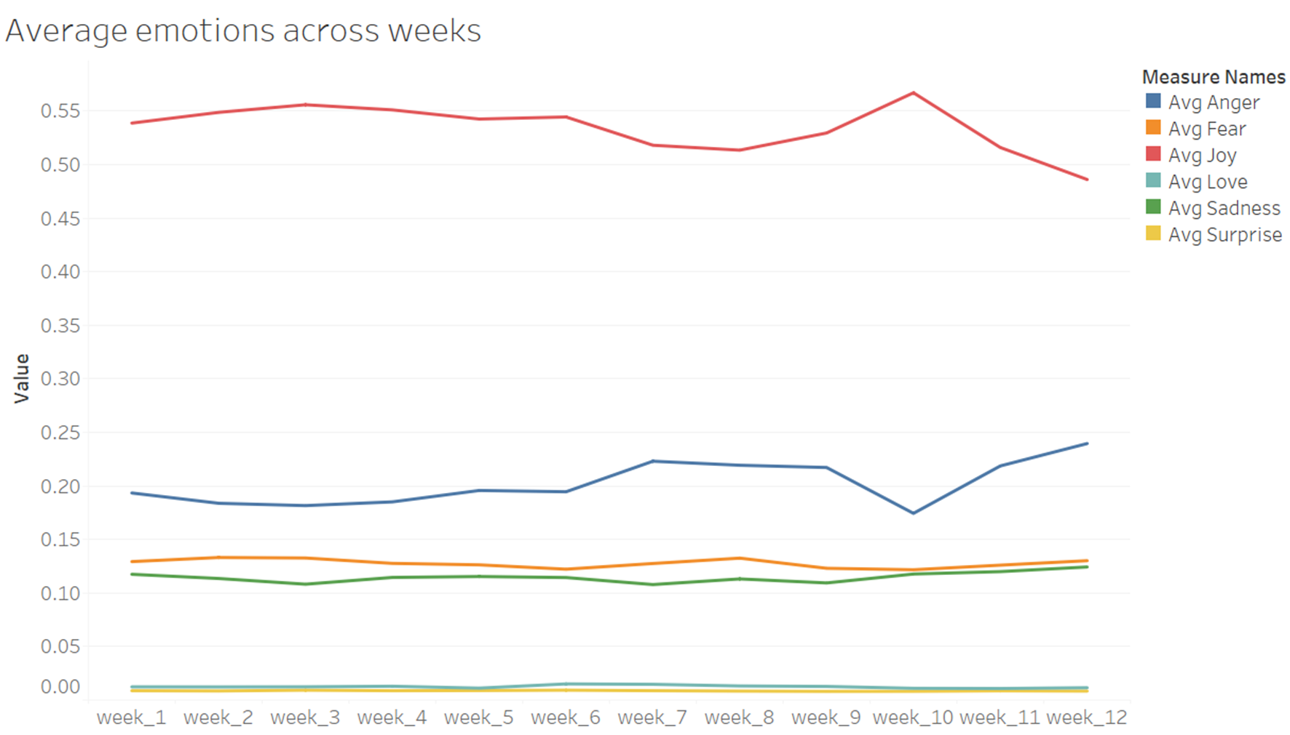
BERT: Average Sentiments across week

Slide 46
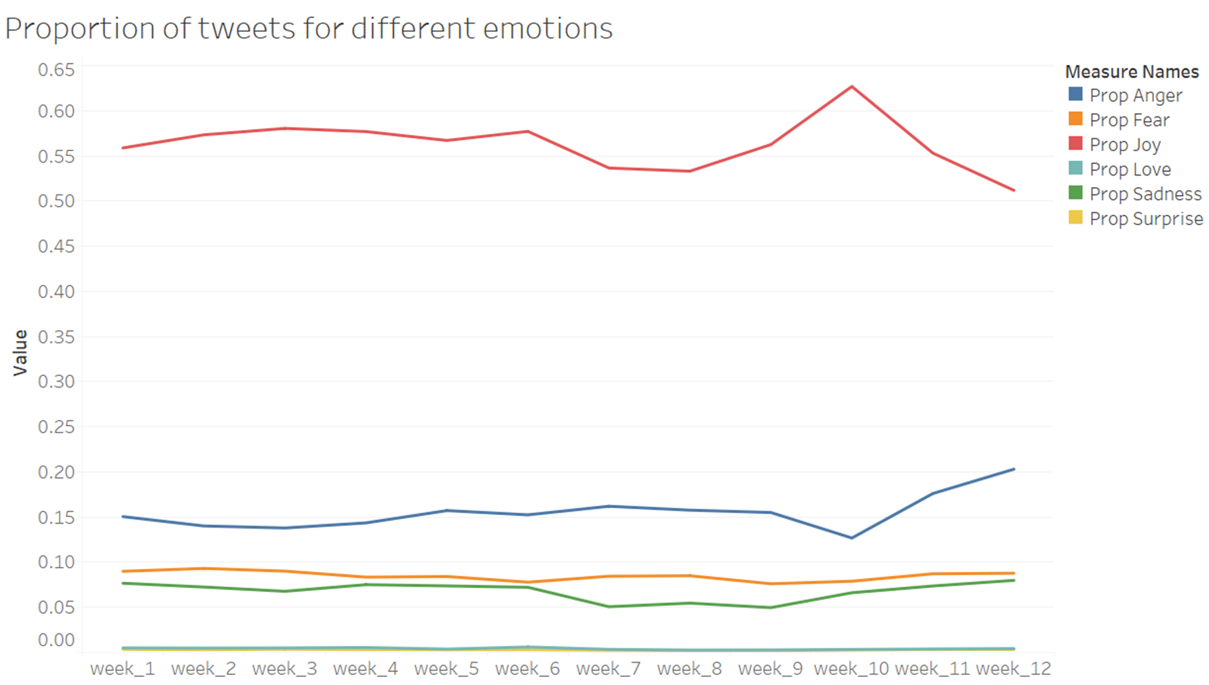
BERT: Proportion of tweets

Slide 47
Conclusion
COVID-19 has impacted millions of individuals throughout the world, and our study reveals how popular topics and sentiments are changing among Twitter users.
Government entities, health care organizations, companies, and leaders working to prevent the COVID-19 epidemic may learn about broader public opinion by assessing changing opinions and trends surrounding a variety of topics. This will enable them to make changes and take corrective actions to prevent the spread of COVID-19.

Slide 48
Thank you!

